Slide 1
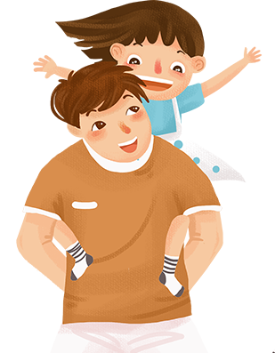
❤ 20XX-06-XX ❤

Slide 2
01
The origin of father’s day
C
on tents
02
About father’s day
03
Celebrate father’s day
04
Father's Day phrase
05
Father‘s Day blessing

Slide 3
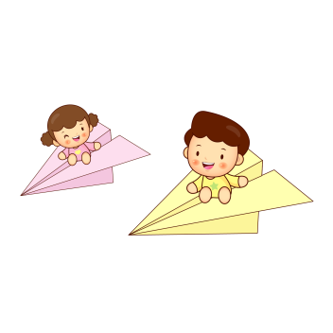
01
The origin of father’s day

Slide 4
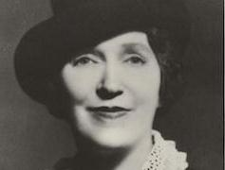
The origin of father’s day
约翰.布鲁斯.多德夫人
Mrs. John B Dodd, of Washington, first proposed the idea of a “father’s day” in 1909. Mrs. Dodd wanted a special day to honor her father William, whose wife died while giving birth to their sixth child. Mr. Smart was left to raise the newborn and his other five children by himself on a rural farm in eastern Washington state. It was after Mrs. Dodd became an adult that she realized the strength and selflessness her father had shown in raising his children as a single parent.

Slide 5
The origin of father’s day
The first Father’s Day was observed on June 19,1910 in Washington. And it was in 1966 that President Lyndon Johnson officially declared the 3rd Sunday of June as Father’s Day.
First
Father’s Day

Slide 6
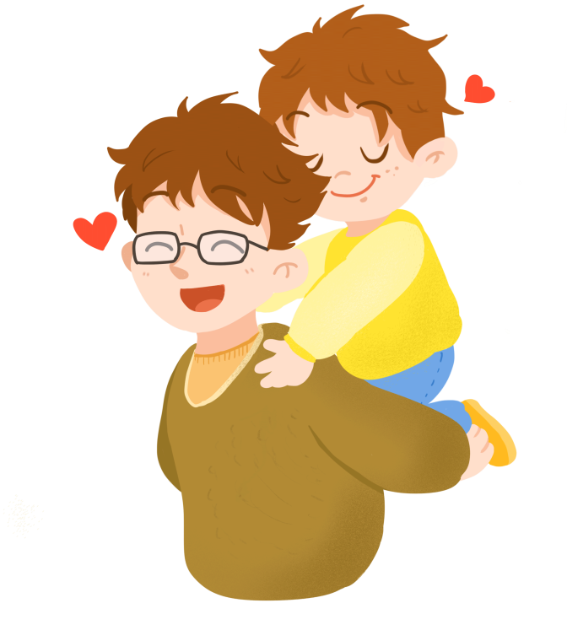
The origin of father’s day
Father’s Day has become a day to not only honor your father, but all men who act as a father figure. Stepfathers, uncles, grandfathers, and adult male friends are all honored on Father’s Day.

Slide 7
02
About father’s day

Slide 8
The meaning for father
F---faithful
A---always there
T---Trust worthy
H---Honoring
E---Ever-loving
R---Righteous

Slide 9
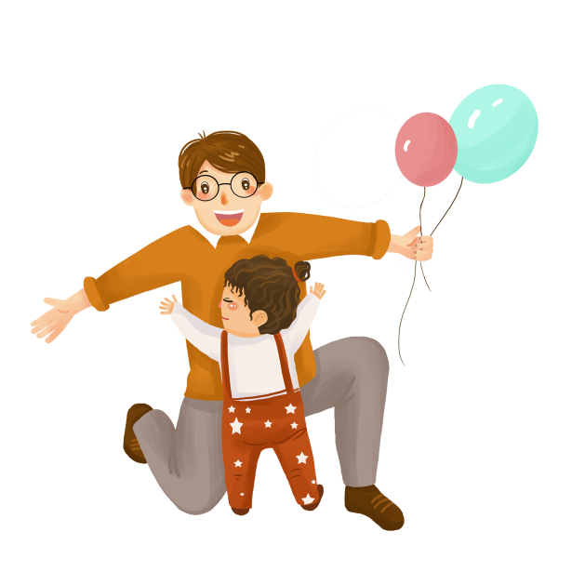
The meaning for father
Different countries have different definitions on father's Day
Chinese Name:
Engish Name:
Father's Day
Source:
the United States National.
Date:
the third sunday of June every year

Slide 10
03
Celebrating Father's Day

Slide 11
Celebrating Father's Day
most people would buy their fathers а card. The card would probably have a nice message in it saying what a great Dad their father is. Some people do buy presents as well.

Slide 12
Celebrating Father's Day
领带
杯子
袜子
巧克力
Popular gifts for Dads are probably ties, chocolates or socks because these are things that Dads can always use even if they don‘t want them. In the run-up (预备期) to Father’ s Day, or indeed Mother‘s Day, there will be adverts ( 留意) (on. the TV giving us ideas of CDs or gadgets we can buy. Card shops will be full of mugs or pens and similar merchandise with word’s Greatest Dad’ written on them.

Slide 13
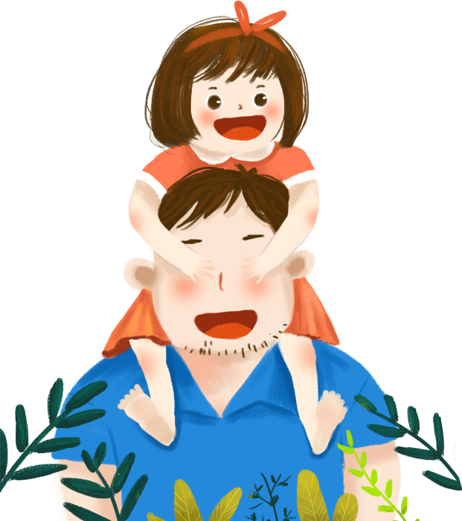
Celebrating Father's Day
title
Some families might do things together to celebrate .Father' s Day like going for a meal. As a special treat, British people might give their Dad a bit of a rest .make him a cup of tea, or even wash his car and mow the lawn to make him feel really appreciated.

Slide 14
Celebrating Father's Day
Best Father's Day Songs
Dance With My Father
Father's Day
Father And Daughter
[ Papa, Can You Hear Me ? ]

Slide 15
04
Father's Day phrase

Slide 16
Father's Day phrase
he wish is father to the thought. | A miserly father makes a prodigal son.
The child is father of the man. | One father can support ten children; the children cannot support one father.
be old enough to be somebody’s father

Slide 17
Father's Day phrase
Many a good father hath but a bad son. | The sins of the fathers are visited upon the children.
One father is more than al hundred school-masters. | The father buys, the son big , the grandchild sells and his son thig.

Slide 18
Father's Day phrase
from father to son | lie with one’s fathers
The father of a whipping | the father of a
Father earns and son spends. | Like father, like son.

Slide 19
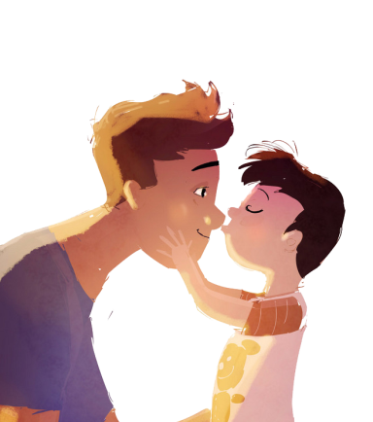
Father's Day phrase
Holy Father
Father оf lіеѕ
The Father of lights
father confessor
Father Christmas
a ghostly father
Father of the Church
Father‘s Day

Slide 20
04
Father‘s Day blessing

Slide 21
Father's Day phrase
1、Over the years we have had our differences, but I always love you.
2、You've been father, friend, adviser, all of these and more.
3、Words can't tell how much you mean to us，we wish you happiness on this special day.
4、On this special day, I want to say I am proud of you . Appreciate all you've done for me and I love you.

Slide 22
Father's Day phrase
5、Thanks for holding my hand when i needed it.
6、Happy father's day to an extraordinary father，I love you so much!
7、I owe all of my skills of fatherhood to you dad. happy father's day.
8、I didn't see what a good father you were to us before, but I do now.

Slide 23
Father's Day phrase
9、Thank you, Dad, for listening and caring, for giving and sharing, for being such a wonderful Dad.
10、 Only wishes that are made with special love will do for a dad who is wonderful in every way as you.
11、On your special day and every day, may love and joy surround you, because you bring such happiness to everyone around you.
节日PPT模板 http://www.1ppt.com/jieri/

