Slide 1
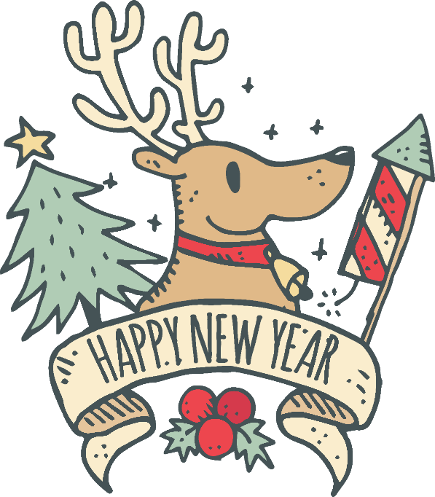

Slide 2
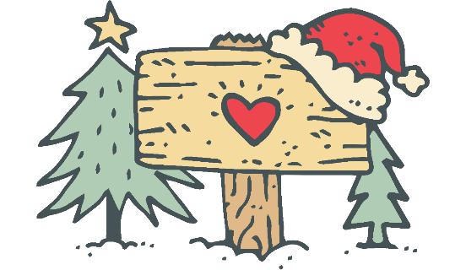
December 25 each year, is the day Christians commemorate the birth of Jesus, known as Christmas.

Slide 3
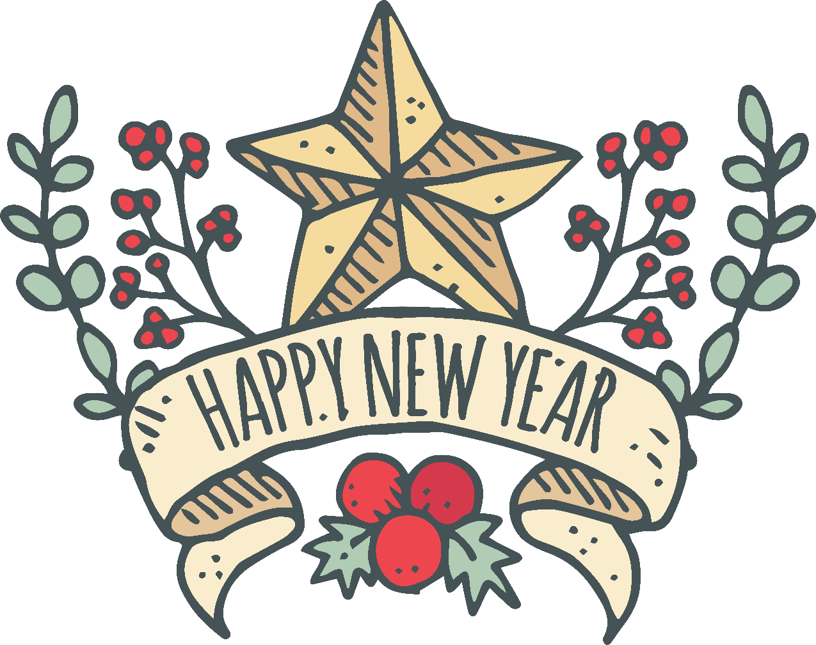
Christmas is the holiday celebrating the birth of Jesus Christ. Although it is a religious holiday , many modern customs and practices associated with it were carried over from other festivals-some religious , some not. What follows is a little background , history and development of the American Christmas celebration.

Slide 4
ORIGIN
Of Christmas

Slide 5
The birth of Jesus in Bethlehem signaled the fulfillment of a long awaited promise that God would send someone , his personal representative, to remove the negative effects of personal evil in the world . Jesus was that representative. Thus his arrival on the human scene , announced by a night sky full of angels ( Luke2:9-14), was good news.
In A.D. 336 the of Christ's birth,obviously trying to reorient the holiday for Christians.When the Empire split between east and west,the church in the east(Eastern Orthodox)recognized January 6th as the celebration date.In many countries January 6th is still honored as the "official"birth date of Chist.The time between December 25th and January 6th forms what has become known as the "12Days of Christmas."
ORIGIN
of
CHCRISMAS

Slide 6
CONTENT
Of Christmas

Slide 7
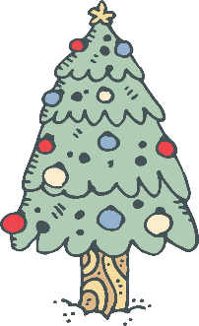
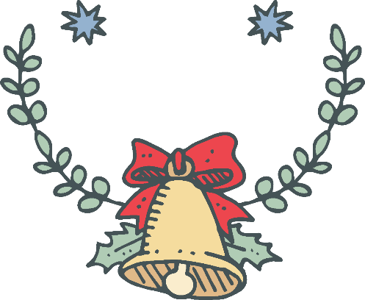
Christmas tree
CONTENT
Christmas carols
Santa Claus
Christmas dinner

Slide 8
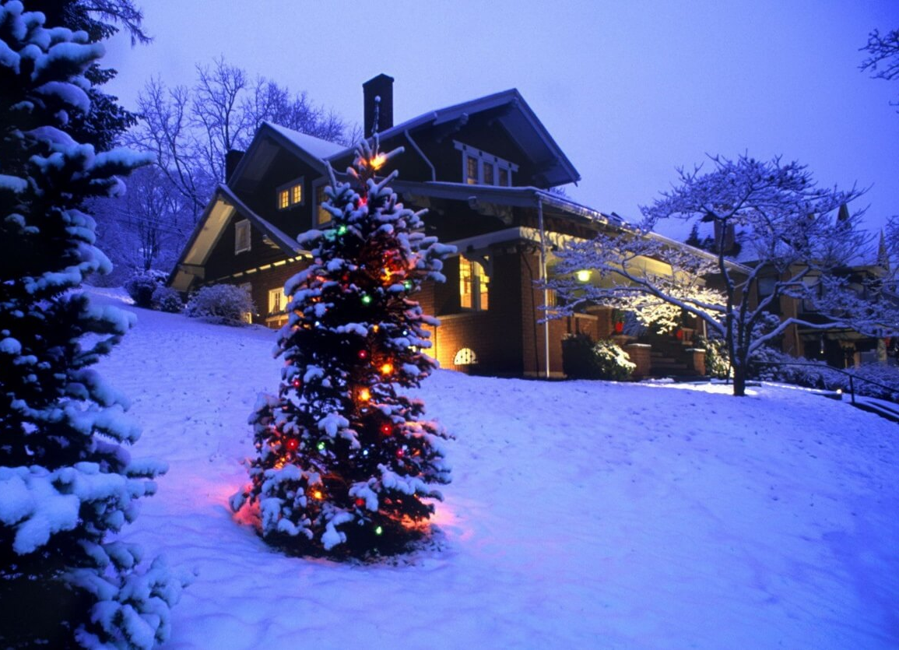
Enhance the festive atmosphere
Be made of evergreen such as cypress
Decorated with a variety of candles ,flowers ,toys ,stars…
Christmas tree

Slide 9
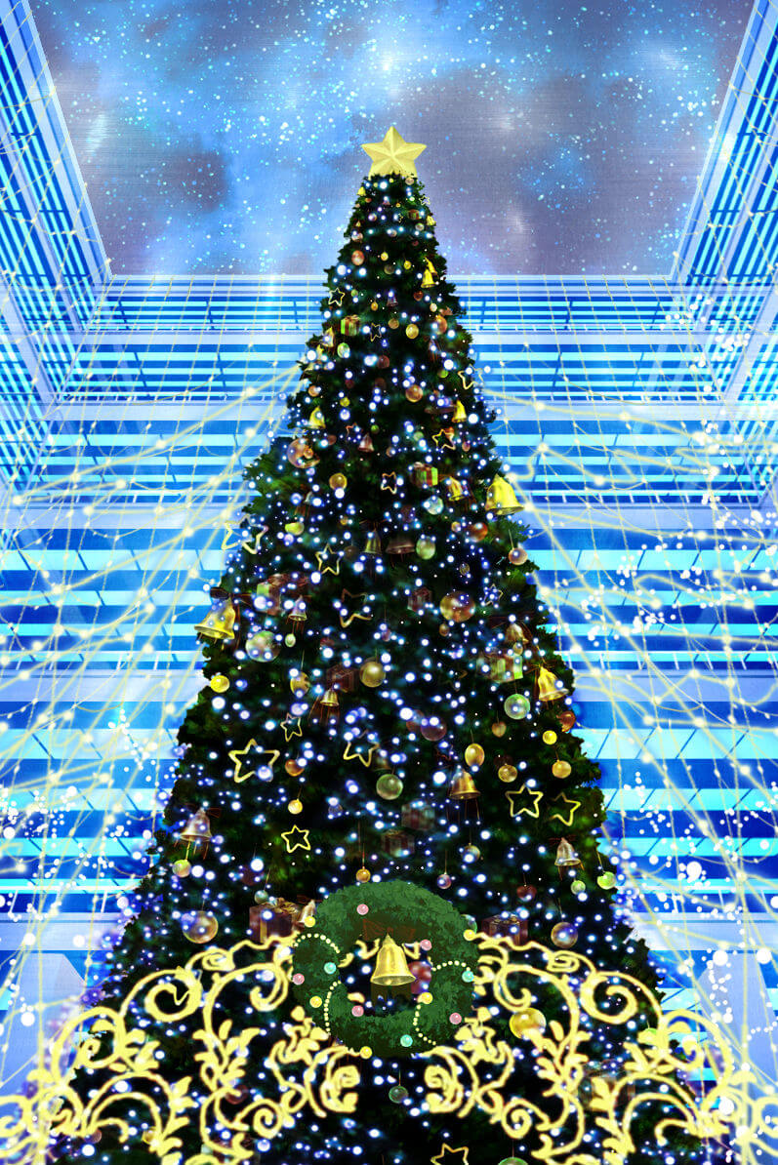
Westerners with red, green and white color for the Christmas colors, Christmas comes every household is decorated with Christmas colors. Red Colored with Christmas flowers and Christmas candles. Green is the Christmas tree. It is the main Christmas ornaments, with the cut to the cedar , cypress tower was a class of decorated evergreen tree. Hanging above the colorful lights, gifts and paper flowers, but also lit the Christmas candles.
Christmas tree

Slide 10
Christmas carols
The first Christmas hymns were written in the 5th Century .Originally composed in Latin,they contained primarily theological topics.
Ninght
First
The first Christmas hymns
第一个圣诞节赞美诗

Slide 11
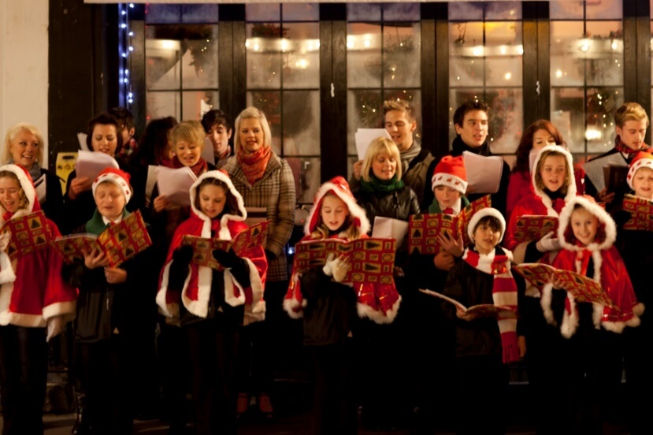
Jingle Bells
Christmas carols
Jingle bells,Jingle bells
Jingle all the way
Oh what fun it is to ride
In a one horse open sleigh
Dashing through the snow
On a one-horse open sleigh
Over the fields we go
Laughing all the way
Bells on bob-tail ring
Making spirits bright
What fun it is to ride and sing
A sleighing song tonight
Jingle bells, Jingle bells
Jingle all the way
Oh what fun it is to ride
In a one-horse open sleigh

Slide 12
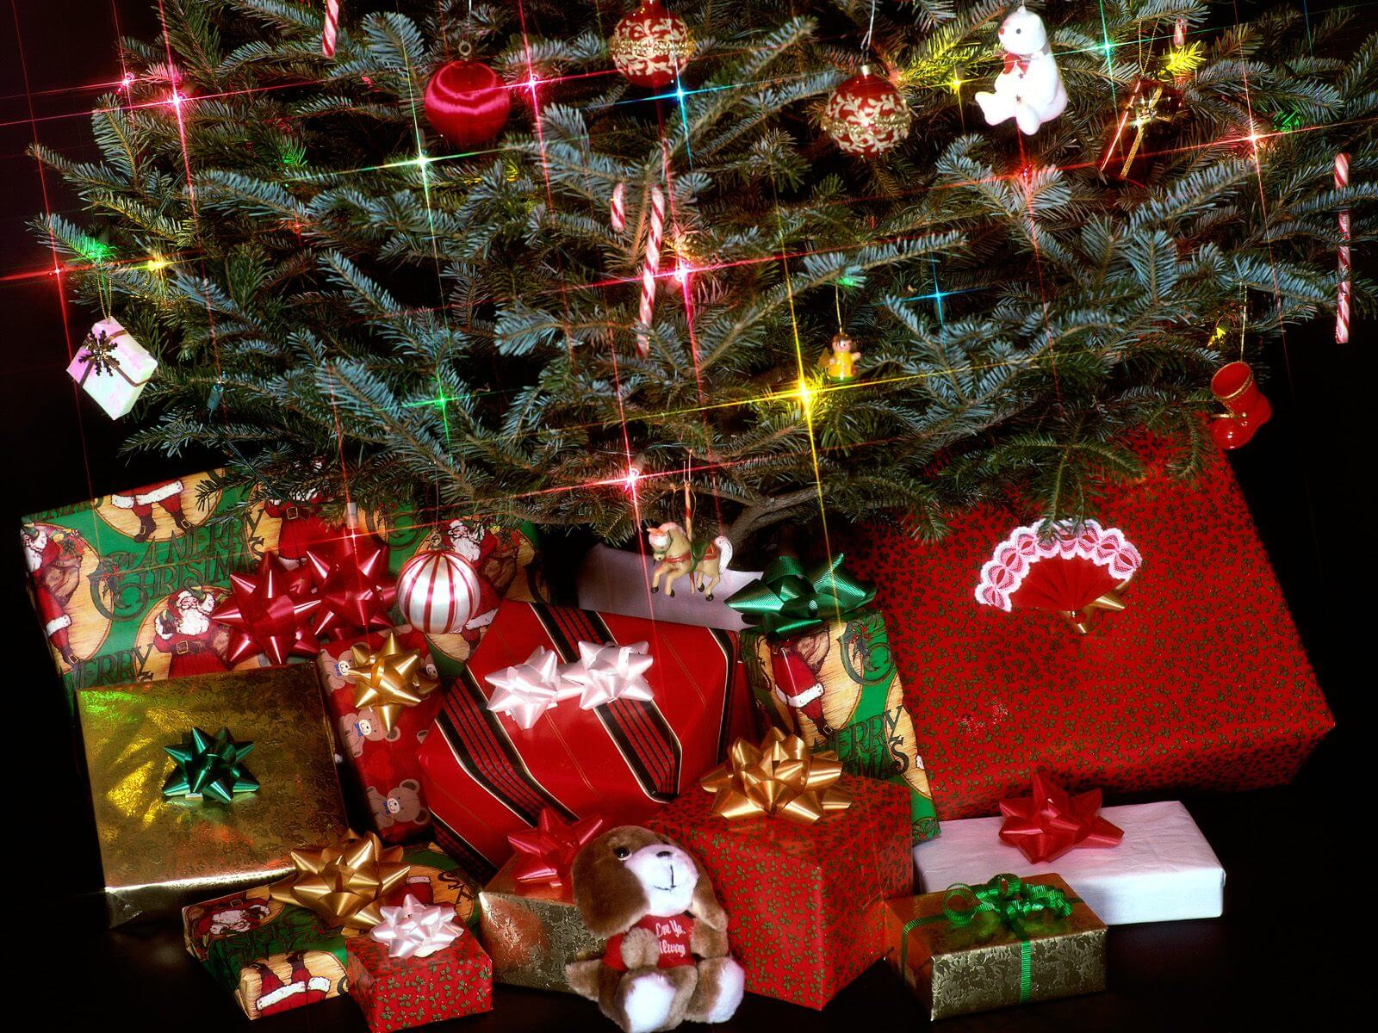
One specifically for the boy to send a gift on Christmas Eve the mysterious figure. Legend to December 24 every night, a mysterious people driving by the 12 reindeer sleigh, going door to door into the house from the chimney, and then secretly put presents under the bed of the socks boy, or heap under the Christmas tree near the fireplace. While no one really ever seen the man look like, but people often dress up as wearing a red Christmas hat, big white beard, a red coat, wearing red boots look like, because there are always gifts on Christmas Eve, so accustomed to call him "Santa Claus."
Santa Claus

Slide 13
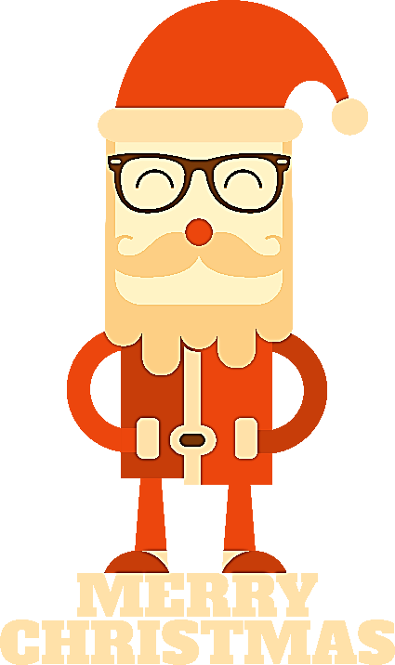
Father Christmas (another name)
Saint Nicholas
imaginary figure
A happy old man with a long white beard and a long red robe
Santa Claus

Slide 14
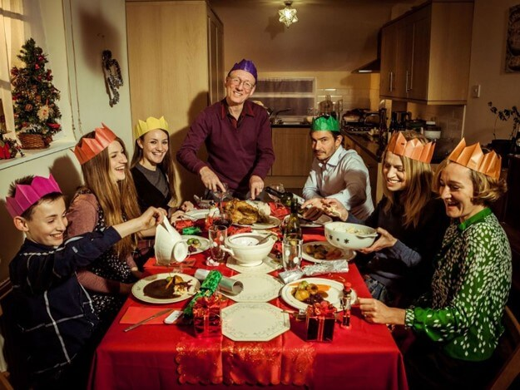
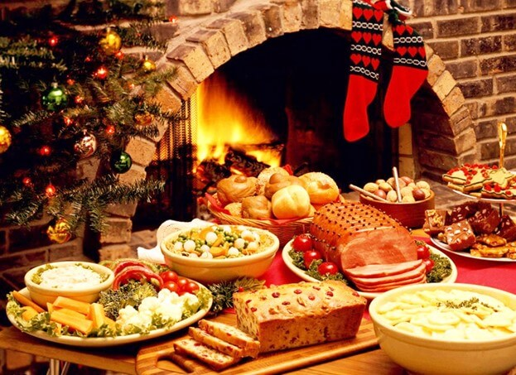
Major food:
Turkey
Roast goose
Puddings
Cookies, Fruit
Eating turkey is popular in the Unite States from 1620.
Christmas Dinner For Family
And enjoy a splendid dinner
Christmas dinner

Slide 15
The specifics of family Christmas celebrations can have as many variations as there are families.Typically families will open presents either on Christmas Eve or Christmas Day.Members may open them at the same time , one at a time, or have some other type of family tradition.Many Christian families will have a birthday cake for Jesus,and sing"Happy Birthday "to Him,in keeping with American birthday celebrations.Christmas is a season where humanity says"Thank you"for God's love by sharing it with and showing it to others.
CELEBRATIONS
OF
CHRISTMAS

Slide 16
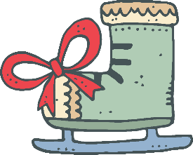
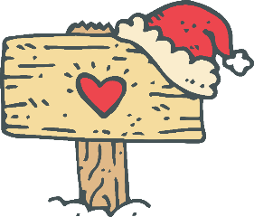
Although the foods served for Christmas dinner may vary from family to family(and from country to country),typical items usually found at an American family's Christmas dinner would include turkey and dressing (or sometimes chicken,duck, goose or ham), potatoes and gravy,sweet potatoes,green vegetables,cranberry,sauce,nuts,fruits,fruit-cake,plum pudding,pumpkin and/or mincemeat pies and sweets.Eggnog is usually the favorite drink for the whole family.

Slide 17
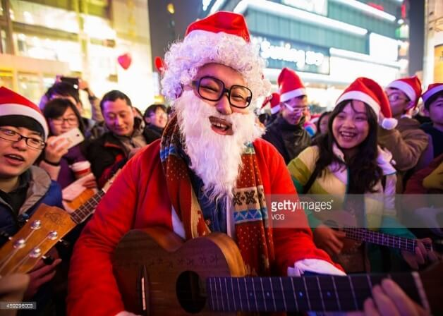
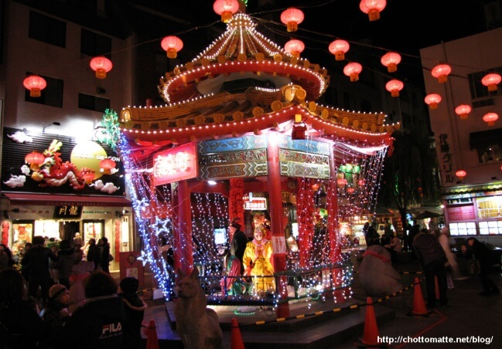
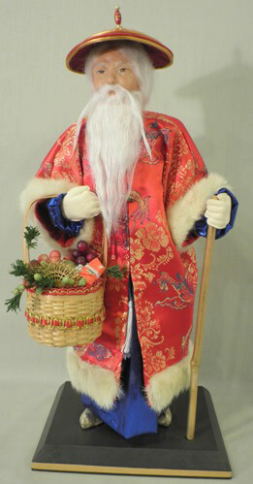
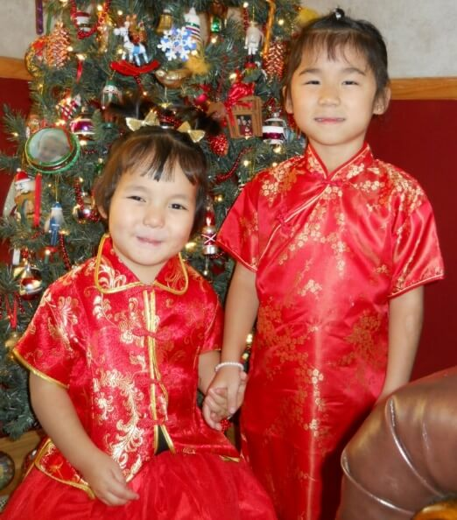
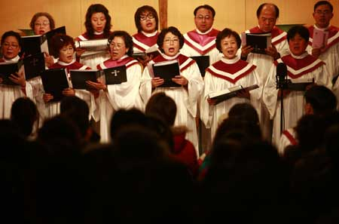
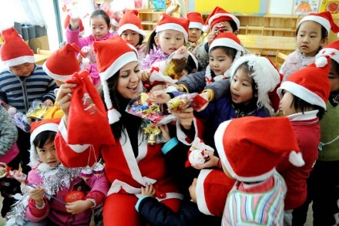
Christmas and Chinese
Christmas in China
Christmas in China
Chinese Old Man
Christmas in China
Christmas and Girl
Church in China
Children in China

Slide 18
For many Chineses,Christmas mean a time for joy and fun rather than a religious event.It’s popular with the young people and they are excited about shopping,eating ,dating and having parties and holding Christmas eve festivity.And of course,Children are eager to receive gifts from Santa Claus.
It’s a good opportunity for restaurants,hotels and stores promote their products or services,so these places have been beautifully decorated with Christmas trees and ornament.Of course,it is also a good chance to futher promote service or products online through search engine optimization and marketing.Many hotels and restaurants offer reservations for Christmas eve dinners,and department stores have prepared enough festive goods to satisfy customers’ shopping needs in China.
CHRISTMAS
In
China

Slide 19
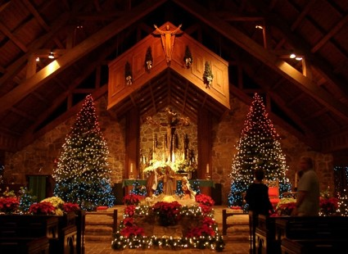
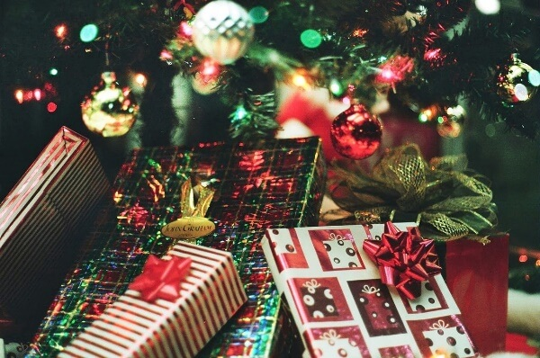
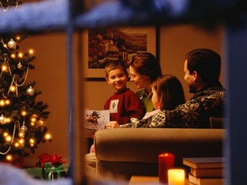
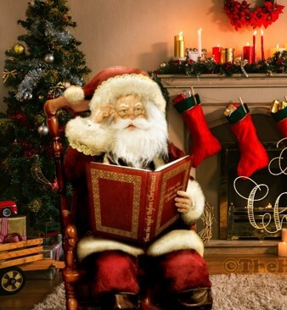
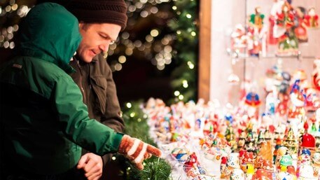
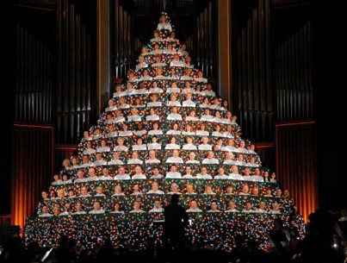
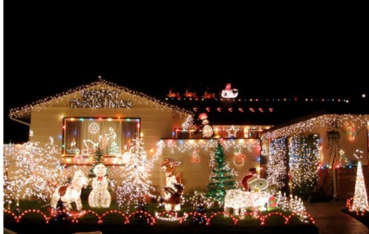
Christmas in foreign country
Christmas in China
Christmas & Church
Christmas and Chinese
Chinese Old Man
Christmas and CHURCH
Christmas
Children

Slide 20
THANK
YOU

