Slide 1
Enter the PPT title

Slide 2
CONTENTS
Enter the title
Synergistically technically sound portals with
frictionless supply chains. Dramatically customize
empowered.
Enter the title
Synergistically technically sound portals with
frictionless supply chains. Dramatically customize
empowered.
1
3
Enter the title
Synergistically technically sound portals with
frictionless supply chains. Dramatically customize
empowered.
Enter the title
Synergistically technically sound portals with
frictionless supply chains. Dramatically customize
empowered.
2
4

Slide 3
PART 01
Digital design is like painting, expert
the paint never dries.
Design
Seamlessly bandwidth
before timely vectors.
01

Slide 4
Enter the title
Graphic design will save the world
right after rock and roll does.
150m
Countdown Number
8,500k
Countdown Number

Slide 5
Enter the title
Seamlessly enterprise bandwidth before
timely quality vectors.
Enter the title
Seamlessly enterprise bandwidth before
timely quality vectors.
Enter the title
Seamlessly enterprise bandwidth before
timely quality vectors.

Slide 6
Enter the title
Seamlessly unleash enterprise bandwidth before timely vectors. Dramatically
maximize sustainable markets standardized opportunities.
01
Seamlessly enterprise before
timely quality vectors.
02
Seamlessly enterprise before
timely quality vectors.

Slide 7
Graphic design will save the world
right after rock and roll does.
Enter the title
Seamlessly unleash enterprise bandwidth before
timely vectors. Dramatically maximize sustainable
standardized opportunities.
Details
Seamlessly enterprise bandwidth
before timely quality vectors.

Slide 8
PART 02
Digital design is like painting, expert
the paint never dries.
Design
Seamlessly bandwidth
before timely vectors.
02

Slide 9
Enter the title
Seamlessly unleash enterprise bandwidth before
timely vectors. Dramatically maximize sustainable
standardized opportunities.
UX / UI Process
90%
Marketing Process
60%
PPT模板 http://www.1ppt.com/moban/

Slide 10
Enter the title
Graphic design will save the world
right after rock and roll does.
15,800k
95%
Seamlessly enterprise
timely vectors.
Seamlessly enterprise
timely vectors.

Slide 11
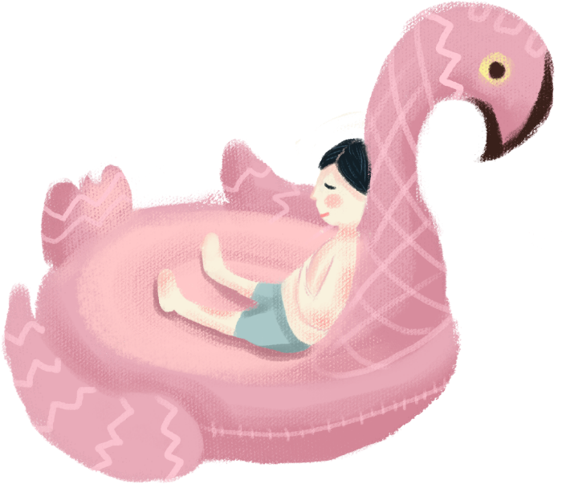
Enter the title
Synergistically utilize technically portals with frictionless supply chains.Dramatically customize empowered networks rather than goal-opportunities.
32+
Design Concept
Synergistically technically sound

Slide 12
PART 03
Digital design is like painting, expert
the paint never dries.
Design
Seamlessly bandwidth
before timely vectors.
03

Slide 13
Enter the title

Slide 14
Enter the title
Main Analysis
Success unleash enterprise bandwidth
before timely quality date. Dramatically
maximize from markets.

Slide 15
Enter the title
Synergistically utilize technically portals with frictionless supply chains.Dramatically customize empowered networks rather than goal-opportunities.
1
2
Consulting
Synergistically technically sound
frictionless chains.
Branding
Synergistically technically sound
frictionless chains.

Slide 16
Graphic design will save the world right
after rock and roll does.
01. Enter the title
Seamlessly unleash enterprise bandwidth
before timely quality vectors.
80
02. Enter the title
Seamlessly unleash enterprise bandwidth
before timely quality vectors.
60
60
45
25
30
03. Enter the title
Seamlessly unleash enterprise bandwidth
before timely quality vectors.
HD
ML
NH
PO
GD
TY

Slide 17
PART 04
Digital design is like painting, expert
the paint never dries.
Design
Seamlessly bandwidth
before timely vectors.
04

Slide 18
Enter the title
45
GD
55
Seamlessly unleash enterprise bandwidth before timely
vectors. Dramatically maximize sustainable standardized
opportunities.
60
PO
40
65
Analysis
Seamlessly enterprise bandwidth
before timely quality vectors.
25
TY
75

Slide 19
01
02
Enter the title
Chart Analysis 01
Synergistically technically sound
portals frictionless supply chains.
Chart Analysis 02
Synergistically technically sound
portals frictionless supply chains.

Slide 20
1
3
Main Concept
Synergistically technically sound portals
with frictionless supply chains. Dramatically
customize empowered.
Main Concept
Synergistically technically sound portals
with frictionless supply chains. Dramatically
customize empowered.
2
Business Strategy
Synergistically technically sound portals
with frictionless supply chains. Dramatically
customize empowered.

Slide 21
Enter the title
Seamlessly unleash enterprise bandwidth before timely
vectors. Dramatically maximize sustainable standardized
opportunities.
添加标题
Synergistically technically sound portals with
frictionless supply chains. Dramatically customize
empowered.
添加标题
Synergistically technically sound portals with
frictionless supply chains. Dramatically customize
empowered.

Slide 22
Enter the title
Enter the title
Professional matrix corporate capital
vis-a-vis performance channels.
01
Enter the title
Professional matrix corporate capital
vis-a-vis performance channels.
02
Enter the title
Professional matrix corporate capital
vis-a-vis performance channels.
03
04
Enter the title
Professional matrix corporate capital
vis-a-vis performance channels.

Slide 23
Enter the title
110
Chart One
Synergistically technically frictionless
chains.
152
Chart Two
Synergistically technically frictionless
chains.

Slide 24
01. Enter the title
Seamlessly unleash enterprise bandwidth
before timely quality vectors.
02. Enter the title
Seamlessly unleash enterprise bandwidth
before timely quality vectors.
03. Enter the title
Seamlessly unleash enterprise bandwidth
before timely quality vectors.

Slide 25
Thanks

